Slide 1

Căpitanu Andreea
Dogăreci Bianca-Alexandra
Ionaşcu Dragoş-Adrian
Diţoiu Andrei-Adelin

Slide 2
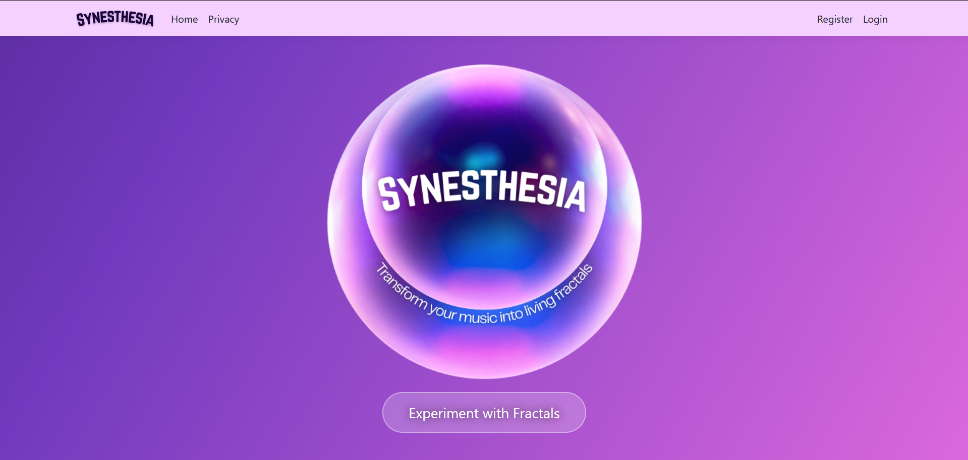

Slide 3
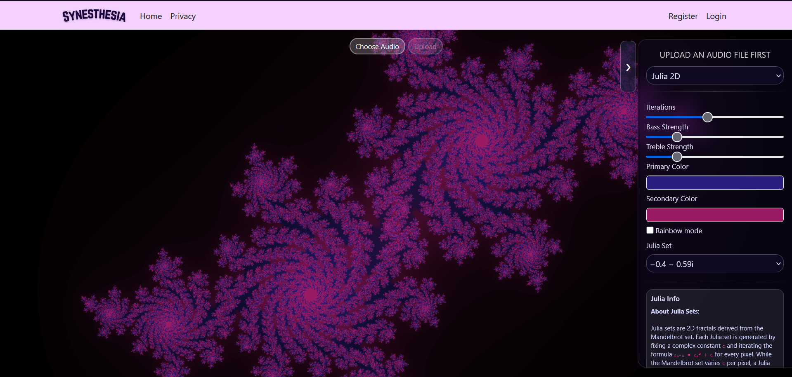

Slide 4
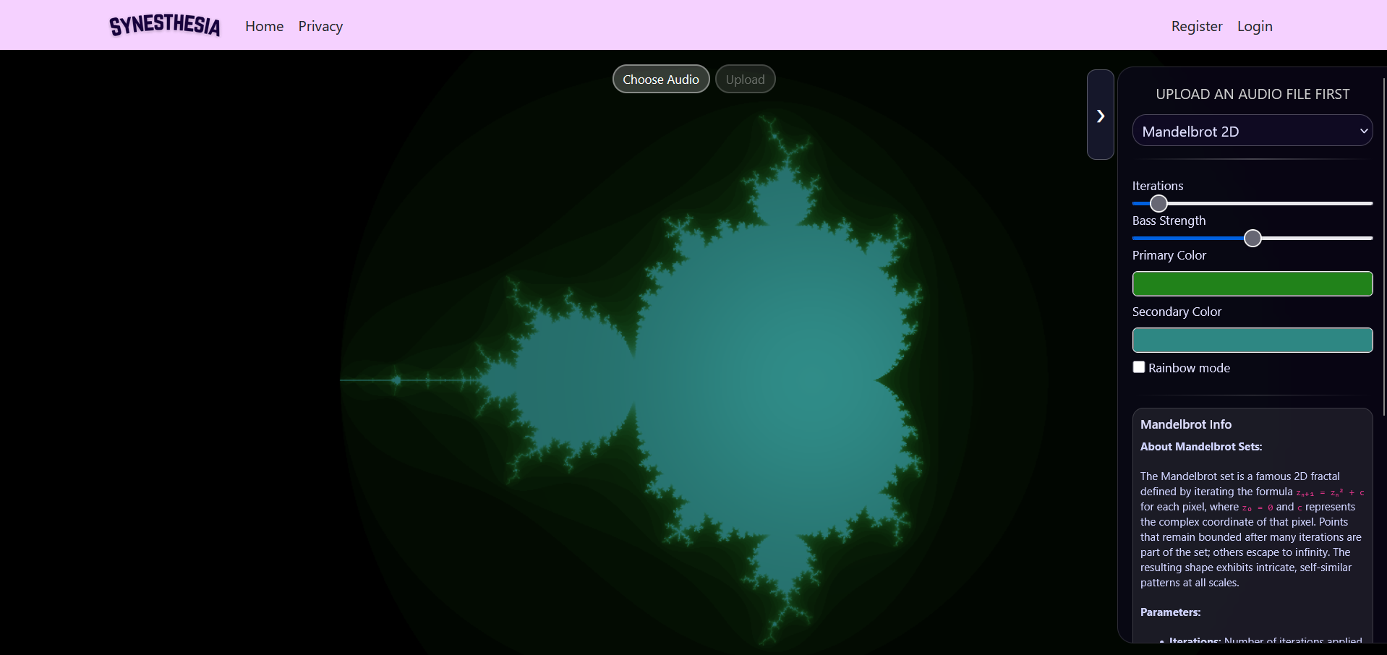

Slide 5
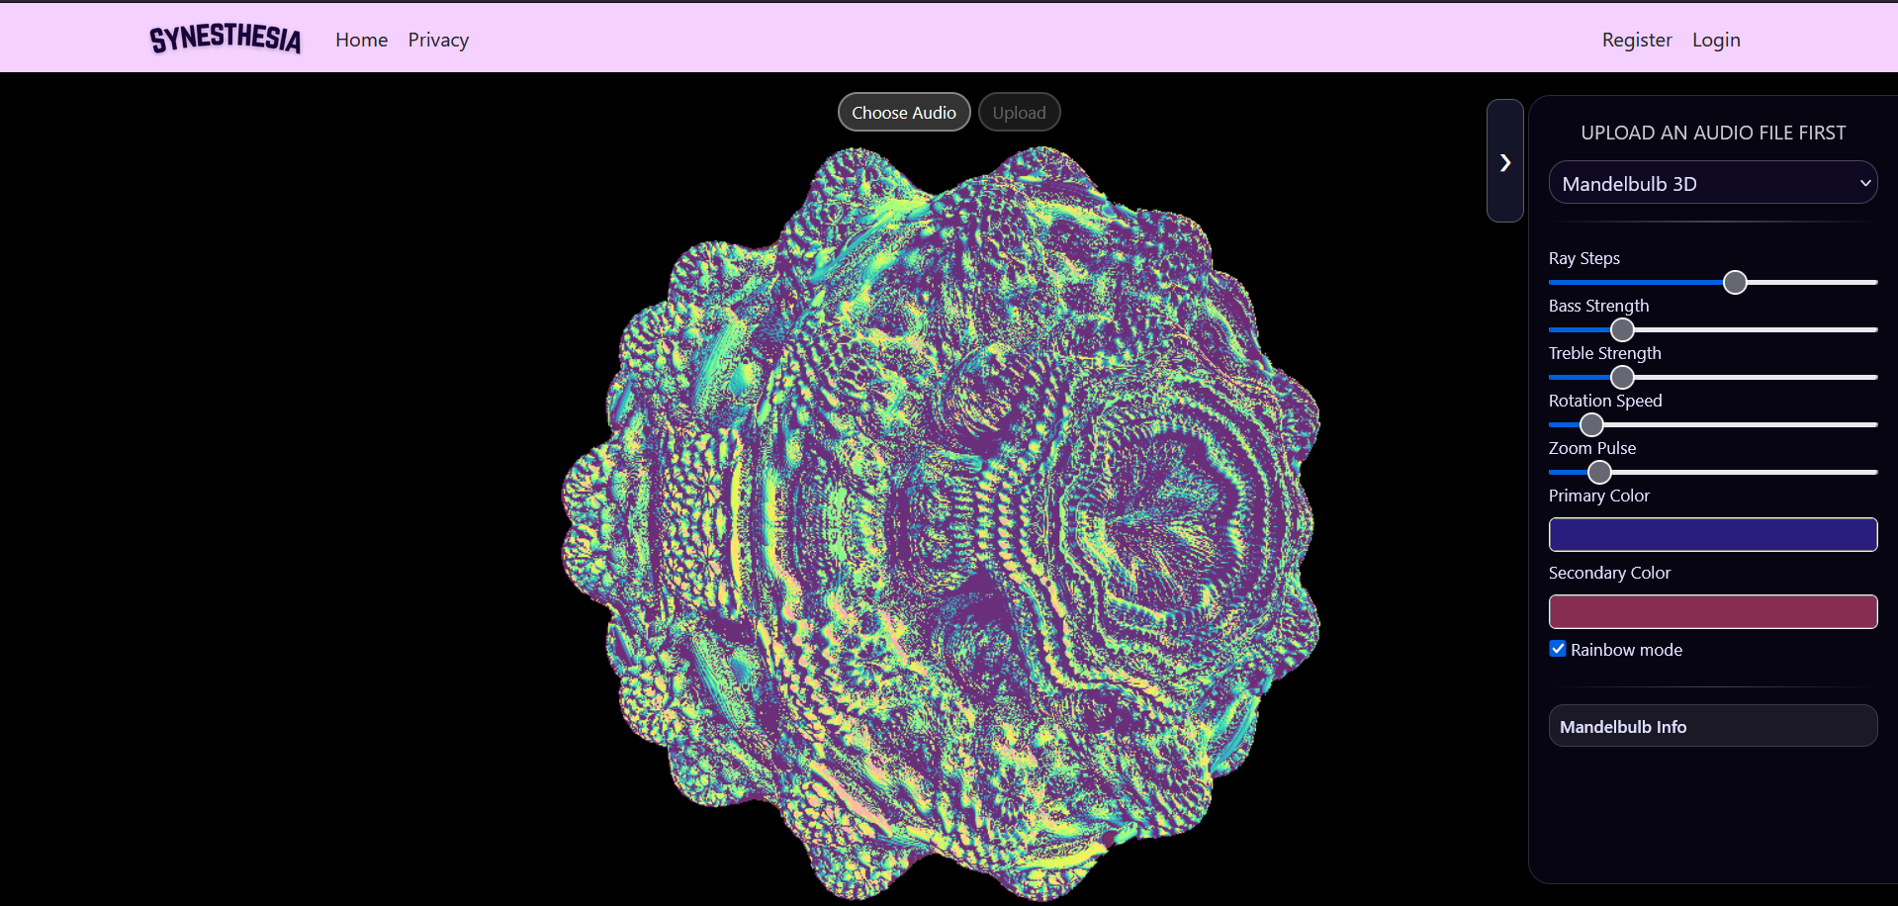

Slide 6
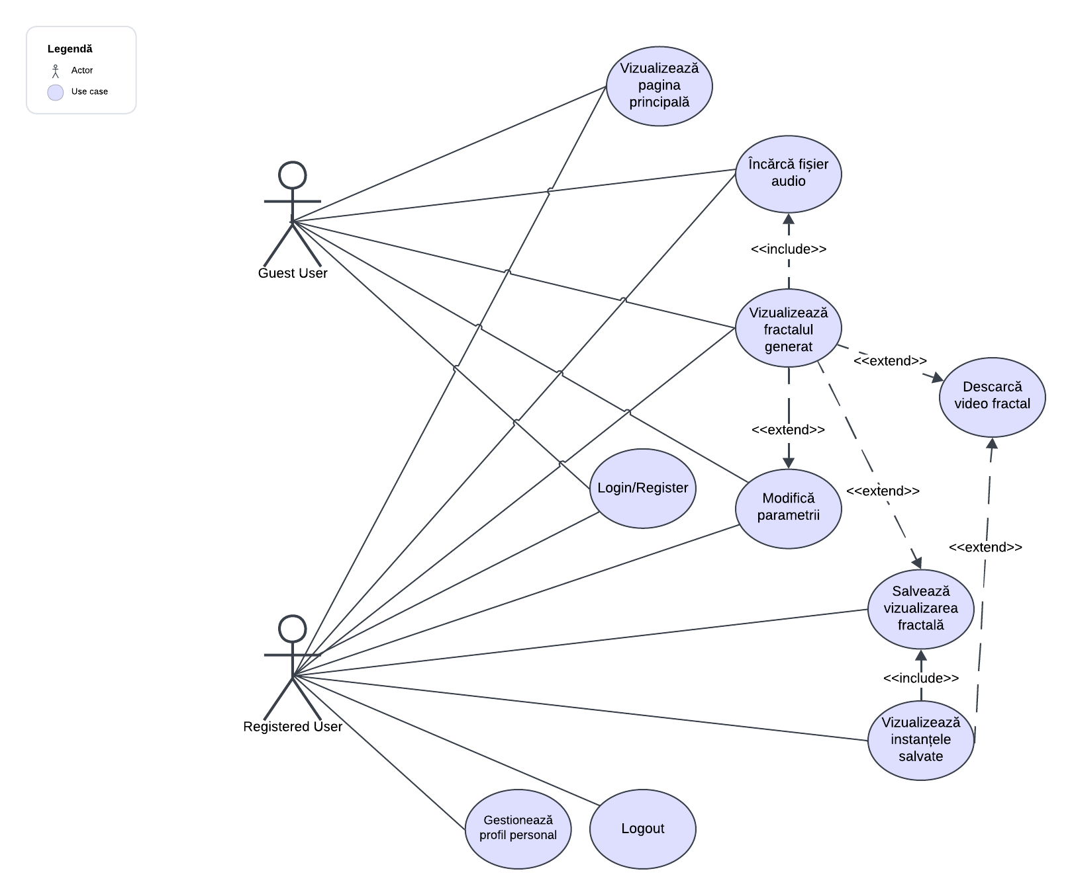
Use Case Diagram

Slide 7




Test-Driven Development
Pair Programming

Slide 8
Test-Driven Development
Follow Red → Green → Refactor
PROS
Helped clarify expected behavior early
Safer refactoring because existing tests immediately detected mistakes
CONS
Only applied to C# logic
Difficult for complex JavaScript logic
Fractal logic evolved frequently, making early tests unstable

Slide 9
Pair Programming
Roles: Driver & Navigator
PROS
When working with complex logic
Instant feedback
Knowledge sharing
Continue work when one person is stuck
CONS
Effectiveness depends on the compatibility of the two developers
Requires good communication and similar coding styles

Slide 10
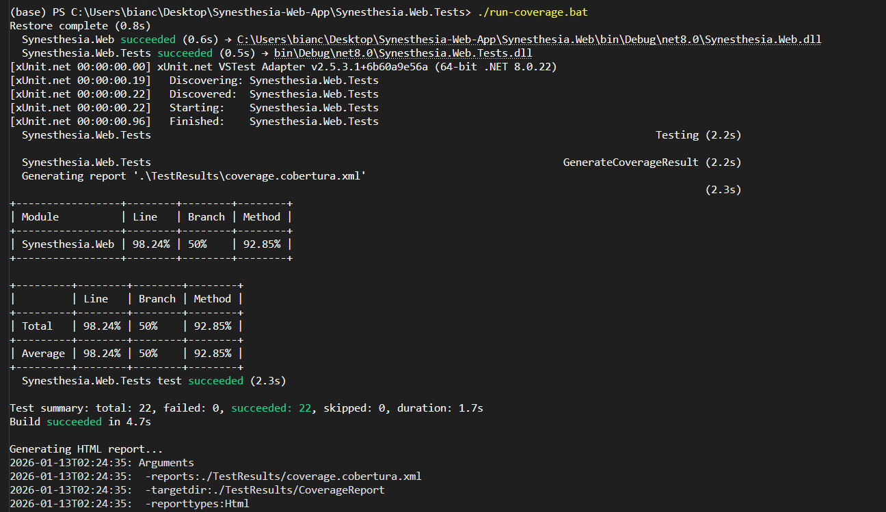
Test Coverage

Slide 11
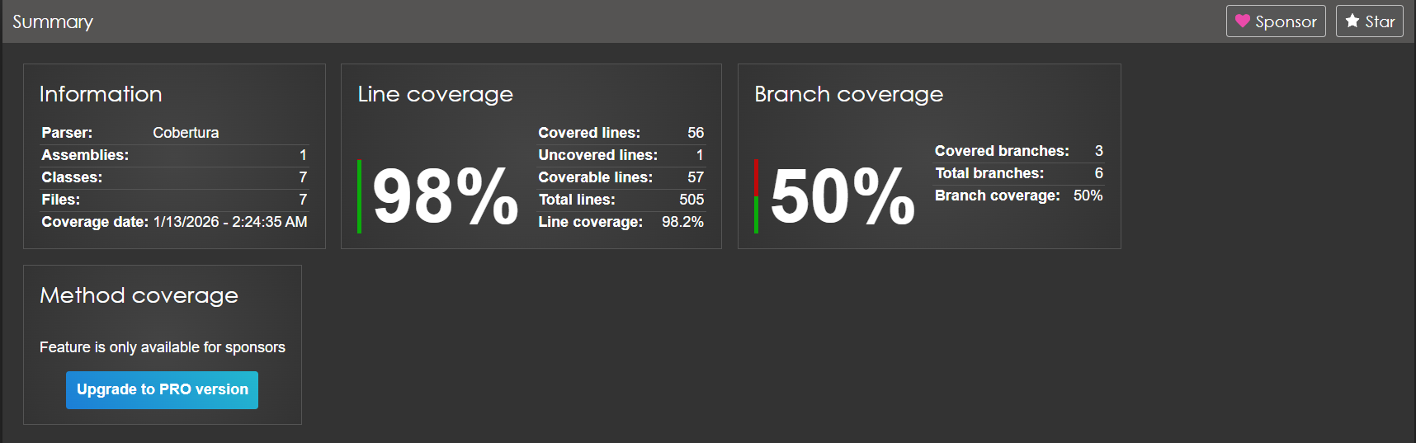
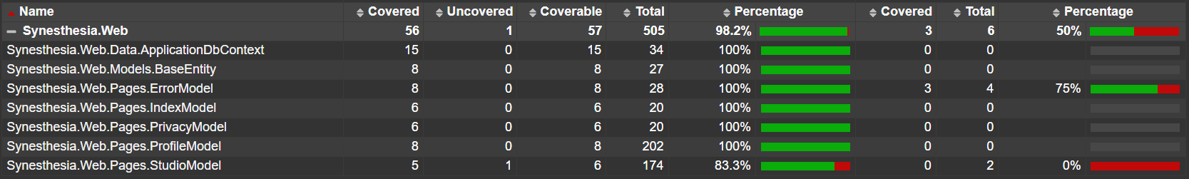
Test Coverage

Slide 12
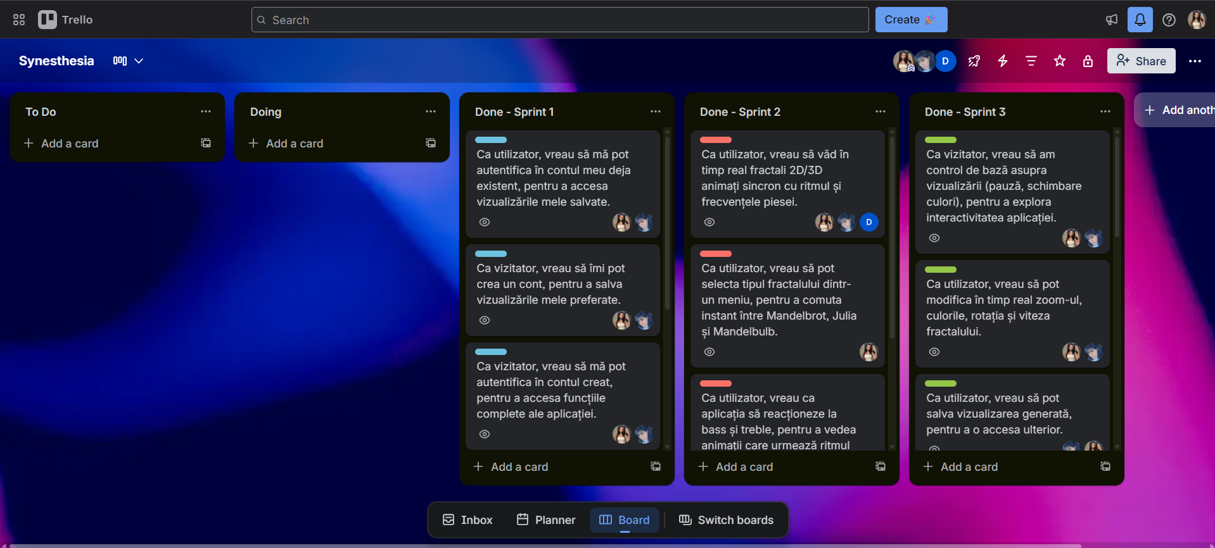
Project Management and Issue Tracking

Slide 13

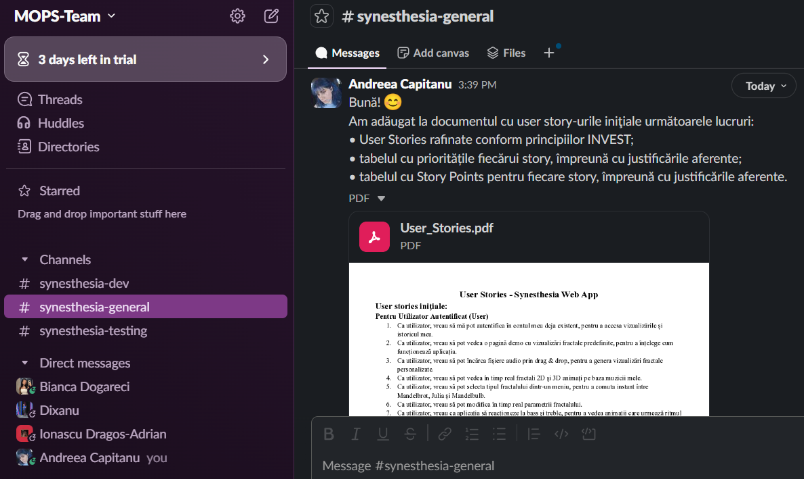
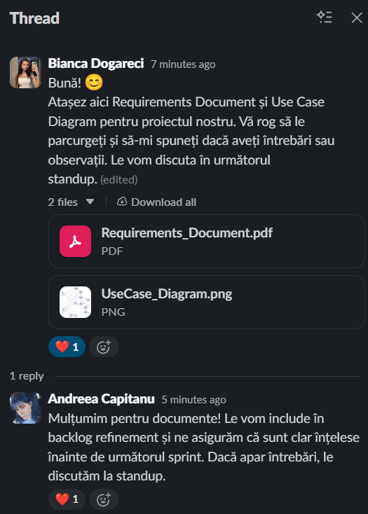

Communication
-> sharing docs etc.
-> pair programming, meetings etc.

Slide 14
Impediments
01
02
Code coverage tool including files like: migrations, ApplicationDbContext.cs etc.
Recording video at a higher quality

Slide 15


Version Control & Collaboration
Link to our GitHub repository!

Slide 16
Contribution of each member
Căpitanu Andreea - 35%
Dogăreci Bianca-Alexandra - 35%
Ionaşcu Dragoş-Adrian - 20%
Diţoiu Andrei-Adelin - 10%

Slide 17
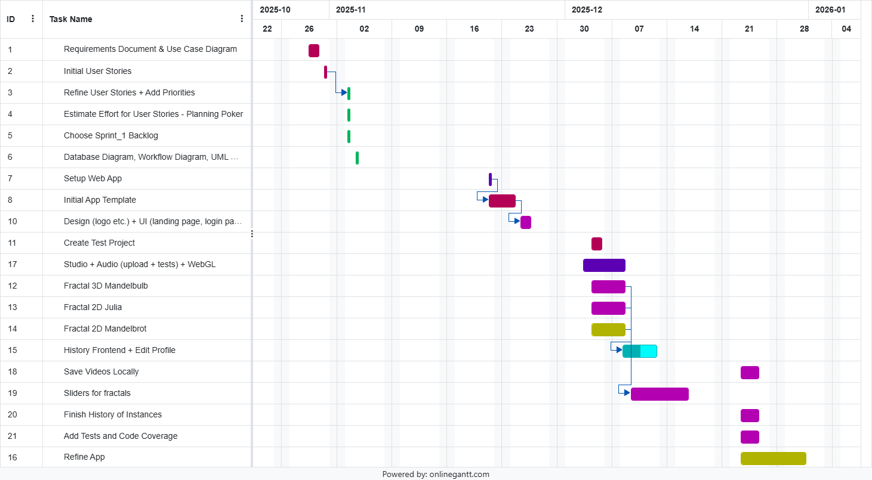

Slide 18
Thank you!

